Slide 1
TankInATank
11/8/2017-Iteration 2
Team 1
Presenting Today:
Qiwei Zheng, Linlan Chen, Lei Yang

Slide 2
Overview
Metrics
New Scene
Bug Fix and Test
Further Moves
New Features improvement
Topic Today

Slide 3
Overview
Moved to the new map
Added new features(fighting mechanism and health mechanism)
Tested previous features more thoroughly and fixed the bugs. (restricting play area, drafting tanks)
Added More Unit Tests.

Slide 4
Metrics
Velocity (how many points worked this iteration):
16 / 21 pts + 4 bugs/testing
Distribution among feature points and bug fix points:
32+ hrs feature development
40+ hrs debugging and testing
Unit Test
20 unit tests for tank shooting, shell explosion, tank movement and tank health point, code coverage 90%, branch coverage 100%

Slide 5
Metrics
Github commit contribution:
Excluding merges, 6 authors have pushed 16 commits to development branches.
Line numbers:
2900+ line additions, 1600+ line deletions
Libraries and auto generated code: 30k+ line additions, 2000+ line deletions

Slide 6
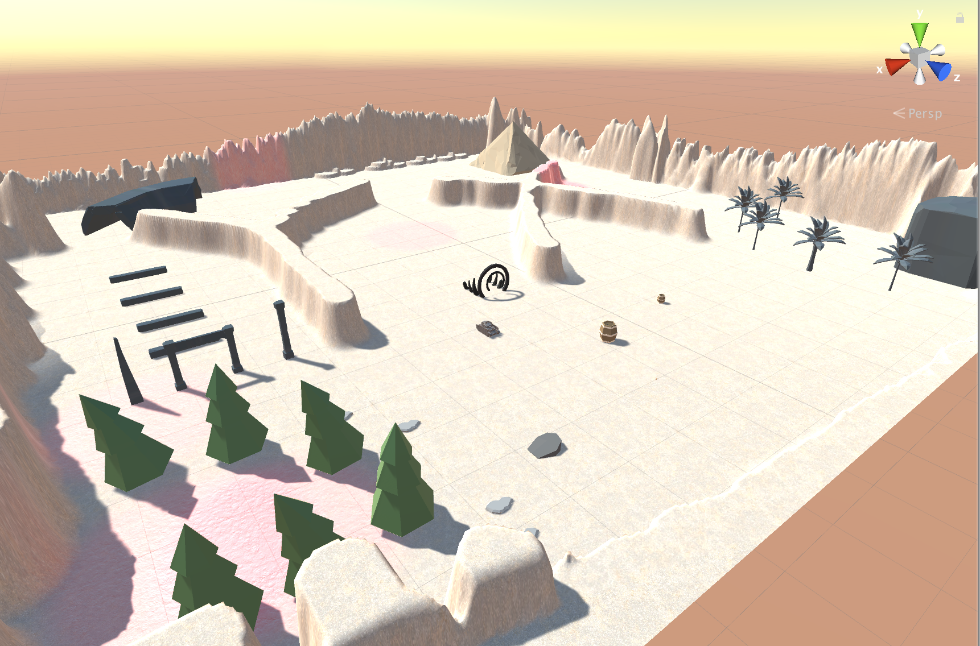
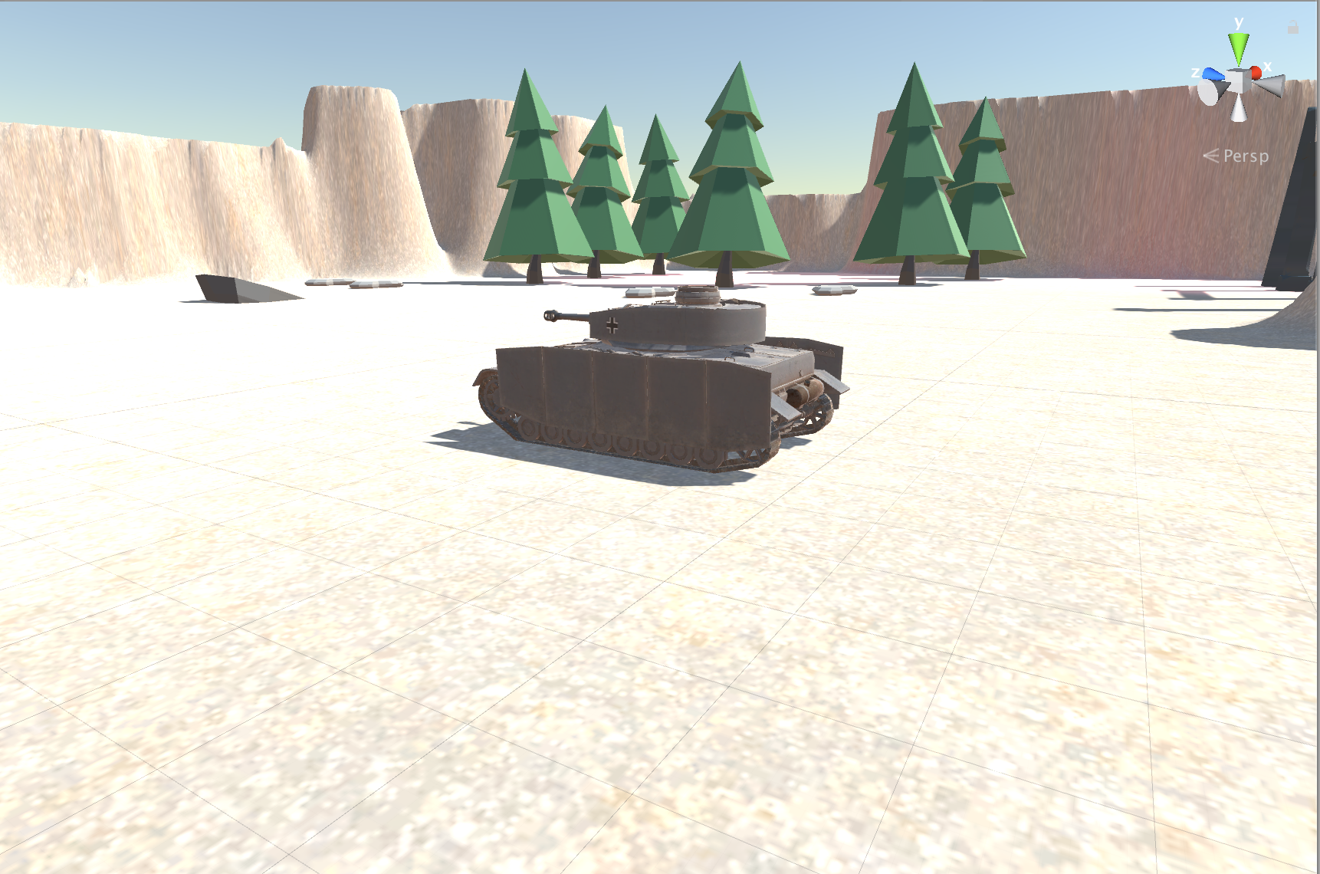
New Map Scene

Slide 7
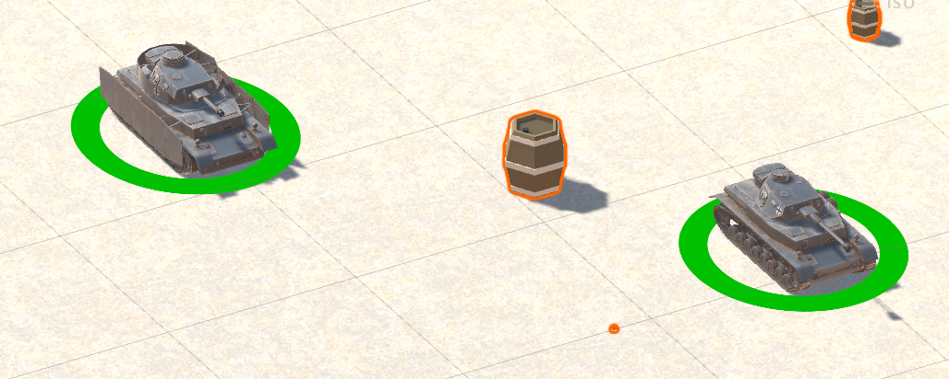
Fighting Mechanism - User Story
As a user, I want to play my tank to fight and see clear damage and destroy results on the screen

Slide 8
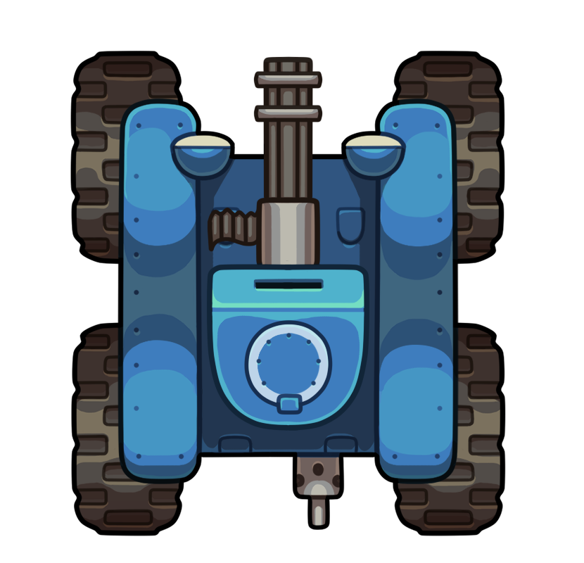
Damage Algorithm 1
50%
0%
Front Armor

Slide 9
Damage Algorithm 2
100%
Back Armor

Slide 10
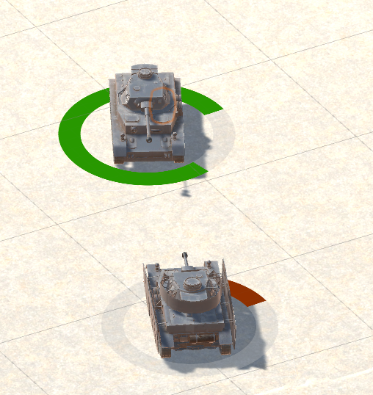
TDD Mode
Given tank has full health, when it got shoot, the health value will drop
Given tank has less than 10% health, when it got deadly shoot, then it will be destroyed

Slide 11
Restricting Playable Area
Unity Game Engine has an intuitive physics system that provide collision detection and Kinematics mechanism.
Rigidbodies and Collider.
We did some of physical system setup in previous iteration and we refined this environment to make sure the tanks stay within the designed playable area.
We Assigned box colliders to all the objects. They detect the position and volumn of object
We assigned rigidbodies to the tanks in order to provide simulation of kinematics movement after collisions.

Slide 12
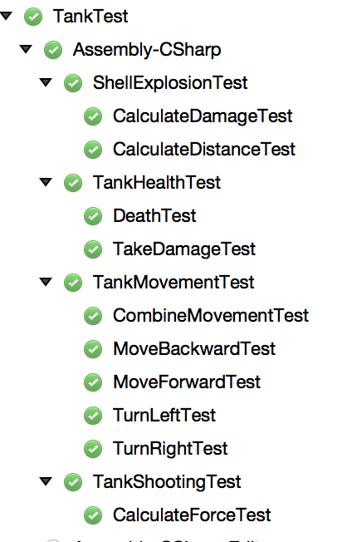
Bug Fix and Test
Unit Test for the code
Using Nunit
Manual Test in play mode

Slide 13
Bug Fix and Test
Terrain Collider bug
Shells were fired from inside of the tank colliders. Triggering colliding mechanism and explode.
When tank continuously move towards an object, the collision detection will fail so that the tank will go through the object.
Drifting tanks

Slide 14
Further moves
Goals for Iteration 3:
Game Manager: map selection, game run manage, start game, pause game, scores
Tank model, shell model
Audio
Refine fighting algorithm
Polish
Documentation
Unity UI Test Automation

Slide 15
Demo

Slide 16
Q&A
11/8/2017-Iteration 2
Team 1
Present Today:
Qiwei Zheng, Linlan Chen, Lei Yang

